Slide 1
Introduction to Purchasing and Supply Chain Management
Chapter 1
CENGAGE LEARNING
Monczka – Handfield – Giunipero – Patterson

Slide 2
A case for todays lecture
In 2020, Apple delayed the launch of the iPhone 12 by several weeks. The reason?
A shortage of semiconductor components from their suppliers in Asia. This single purchasing and sourcing problem cost Apple a millions in lost revenue and damaged customer excitement.
Today, we will learn how purchasing decisions—and supplier management—can make or break a company. This is not a back‑office function. This is a strategy.

Slide 3
Chapter Overview
A new competitive environment
Why purchasing is important
Understanding the language of purchasing and supply chain management
The supply chain umbrella
Purchasing & Supply Chain Management, 4e

Slide 4
Learning outcomes
Four enablers of purchasing and supply chain management
The evolution of purchasing and supply chain management
Looking ahead
Purchasing & Supply Chain Management, 4e

Slide 5
A New Competitive Environment
Increasing numbers of world-class competitors
Sophisticated customer base
  More performance at a lower cost
Widely available information sources
Balance of power between buyers and suppliers
Greater outsourcing
Purchasing & Supply Chain Management, 4e

Slide 6
Factors Driving SCM
Low cost and wide availability of information more closely links the members of a supply chain
Competition in domestic and international markets requires quickness, agility, and flexibility
Purchasing & Supply Chain Management, 4e

Slide 7
Factors Driving SCM
Customer expectations and requirements are more demanding
Major disruptions require the ability of a supply chain to react rapidly
Competition between supply chains, not just companies
Purchasing & Supply Chain Management, 4e

Slide 8
Why Purchasing Is Important
Purchased content is a significant part of the cost of goods sold (≥ 55%)-APQC
Move from traditional, adversarial buyer-supplier relations to improve supply chain performance
Purchased content’s impact on product and service quality
Purchasing & Supply Chain Management, 4e

Slide 9
Why Purchasing Is Important
Participation in product and process design
Use of cross-functional teams
Early supplier involvement
The supply chain’s impact on competitive advantage
Purchasing & Supply Chain Management, 4e

Slide 10
Language of Purchasing and SCM
Are supply chains and value chains the same?
What is supply chain management?
What is an extended enterprise?
Purchasing & Supply Chain Management, 4e

Slide 11
Purchasing
A functional group (i.e., a formal entity on the organization chart) as well as a functional activity (i.e., buying goods and services)
Aka as procurement
Purchasing & Supply Chain Management, 4e

Slide 12
Open Discussion Question
"Let's Discuss: What Can Go Wrong in Purchasing?"
"You are a procurement manager at a Saudi manufacturing company. You must source a critical component from suppliers. What are the top 3 risks you face if you manage purchasing poorly?“
Instructions: "Take 5 minutes. Work in pairs. Think about real risks: cost, quality, delivery, supplier reliability, geopolitical issues, currency risk, anything. Write them down. After 5 minutes, we will hear from each group."
Purchasing & Supply Chain Management, 4e

Slide 13
Expected Answers
Overpaying for materials → profit margins shrink
Poor supplier quality → defective products → customer complaints
Late deliveries → production stops → missed deadlines
Single supplier dependency → blackmail or failure = business stops
Unethical suppliers → legal and reputational damage
Currency fluctuations → unexpected cost increases
Geopolitical disruptions → supply interrupted

Slide 14
Supply Management
A strategic approach to planning for and acquiring the organization’s current and future needs through effectively managing the supply base, utilizing a process orientation in conjunction with cross-functional teams to achieve the organizational mission
Purchasing & Supply Chain Management, 4e

Slide 15
ISM’s Definition
The identification, acquisition, access, positioning, and management of resources and related capabilities an organization needs or potentially needs in the attainment of its strategic objectives
Purchasing & Supply Chain Management, 4e

Slide 16

Defining Supply Management
Strategic Orientation
Supply Base Management
Cross Functional Groups
Process-Driven Approach

Slide 17
Supply Chains and Value Chains
Supply chain orientation – a higher level recognition of the strategic value of managing operational activities and flows within and across a supply chain
Purchasing & Supply Chain Management, 4e

Slide 18
Supply Chains and Value Chains
Value chain – primary and secondary support activities that can lead to competitive advantage
Supply chain – a set of 3 or more organizations linked directly by 1 or more of the upstream or downstream flows of products, services, finances, and information from a source to a customer (subset of a value chain)
Purchasing & Supply Chain Management, 4e

Slide 19
The Extended Value Chain
Firm infrastructure
Human resource management
Technology development
Purchasing
Support Activities
Materials/Services
Information/Funds/Knowledge
Inbound Logistics
Outbound Logistics
Marketing & Sales
Customer Service
Suppliers
Operations
Customers
Primary Activities
Materials / Supply Management
Physical Distribution / Channel Management
Total Supply Chain / Total Logistics Management

Slide 20
Supply Chain vs. Value Chain
Supply chain management – endorses a supply chain orientation and involves proactive management of the 2-way movement and coordination of goods , services, information, and funds from raw material through end user
Purchasing & Supply Chain Management, 4e

Slide 21
Cereal Value Chain Example
Grain
Cereal
Farmer
Processor
Packaging
Distributor
Packaged Cereal
Paperboard
Grocer
Corrugated Box Mfr
Wood
Consumer
Labels
Lumber Company
Label
Mfr
Material
Information
Purchasing & Supply Chain Management, 4e

Slide 22
Critical SCM Processes
New product development
Customer-order fulfillment
Supplier evaluation and selection
Demand and supply planning
Purchasing & Supply Chain Management, 4e

Slide 23
The Supply Chain Umbrella
Purchasing
Inbound transportation
Quality control
Demand and supply planning
Receiving, materials handling, and storage
Material or inventory control
Purchasing & Supply Chain Management, 4e

Slide 24
The Supply Chain Umbrella
Order processing
Production planning, scheduling, and control
Warehousing/distribution
Shipping
Outbound transportation
Customer service
Purchasing & Supply Chain Management, 4e

Slide 25
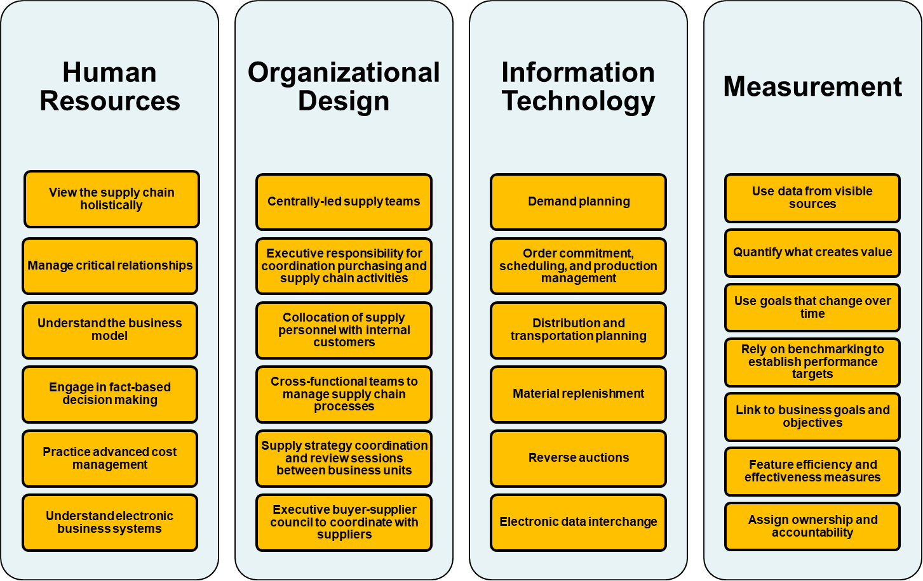
Enablers of Purchasing and SCM

Slide 26
Capable Human Resources
Supplier relationship management
Total cost analysis
Purchasing strategies
Supplier analysis
Competitive market analysis
Purchasing & Supply Chain Management, 4e

Slide 27
Proper Organizational Design
Assessing and selecting the structure and formal system of communication
Division of labor
Coordination
Control
Authority
Responsibility
Purchasing & Supply Chain Management, 4e

Slide 28
Real-Time and Shared IT Capabilities
Supply chain planning
  Forecast accuracy
  Optimized production scheduling
  Reduced working capital costs
  Shortened life cycles
  Reduced transportation costs
  Improved customer service
Purchasing & Supply Chain Management, 4e

Slide 29
Real-Time and Shared IT Capabilities
Supply chain execution
  Obtaining materials
  Managing physical flows
Purchasing & Supply Chain Management, 4e

Slide 30
Emerging SCM Technologies
Global positioning systems
Internet-based systems
Bar codes
Radio frequency identification devices
Wireless devices
Purchasing & Supply Chain Management, 4e

Slide 31
Roadblocks to Measurement Systems
Too many metrics
Debate over the correct metrics
Constantly changing metrics
Old data
Purchasing & Supply Chain Management, 4e

Slide 32
Why Is Measurement Important?
Supports fact-based decision making
Communicates requirements through the supply chain
Improves future supplier performance
Recognizes outstanding performance
Links critical measures to desired outcomes
Determines if initiatives are working
Purchasing & Supply Chain Management, 4e

Slide 33
Closing Remarks
Remember: In most manufacturing companies, more than 55 percent of the cost of goods sold comes from suppliers. That means every dollar saved in purchasing goes directly to profit. Every quality improvement in a supplier improves your product. Every delay in delivery damages your customers. This is why strategic purchasing is so critical.
Purchasing & Supply Chain Management, 4e

